Slide 1
UNMANNED AERIAL VEHICLE FOR DISASTER MANAGEMENT RESCUE AND CRIME DETECTION
PROJECT SUPERVISOR | BY
Ms.Suruthi S | Allwin Meshach Hezron T | 310620106012
Assistant Professor | Bhuvaneshwaran L | 310620106021

Slide 2
OUTLINE
OBJECTIVES
INTRODUCTION
PROPOSED METHODOLOGY
BLOCK DIAGRAM
HARDWARE AND SOFTWARE REQUIREMENTS WITH SPECIFICATIONS
EXPECTED OUTCOMES
CONCLUSION
REFERENCES – PEER REVIEWED JOURNALS ONLY

Slide 3
OBJECTIVES
This thesis deals with location determining, also known as positioning, using unmanned vehicles. The goal is to implement a low cost outdoor system which utilize arial vehicles. Two main methods are search and rescue.
Previous efforts with unmanned systems concentrate on methods, mainly the low- power image stitching management (LPISM) that can reduce power consumptions of the UAVs that take images for image stitching in the disaster management system.

Slide 4
INTRODUCTION
A unmanned arial vehicle or UAV with networking capabilities is described.
Normal UAVs uses RF Signal Transmitter for movements, transmitter range must be big to ensure satisfactory range in searching.
This RF system was removed and a novel use of Path Planning Algorithms allowed a series of improvements to be made.
The distance was estimated between a Reference transmitter and a mobile receiver, using a Line-Of-Sight radio propagation model within a single cell.

Slide 5
LITERATURE SURVEY
S.NO | JOURNAL DETAILS | TECHNIQUES USED | INFERENCE
1. | Pantic, M., & Patras, I. (2006). Dynamics of facial expression: recognition of facial actions and their temporal segments from face profile image sequences. IEEE Transactions on Systems, Man and Cybernetics, Part B (Cybernetics), 36(2), 433– 449. doi:10.1109/tsmcb.2005.859075 | Auxiliary Particle Filtering | Automating the analysis of facial signals, especially rapid facial signals
2. | Teuliere, C., Marchand, E., & Eck, L. (2015). 3-D Model-Based Tracking for UAV Indoor Localization. IEEE Transactions on Cybernetics, 45(5), 869–879. doi:10.1109/tcyb.2014.2337652 I | Multiple hypotheses registration and particle filtering | 3-D Model-Based Tracking for UAV Outdoor Localization
3. | Araujo, P., Fontinele, J., & Oliveira, L. (2019). Multi- Perspective Object Detection for Remote Criminal Analysis Using Drones. IEEE Geoscience and Remote Sensing Letters, 1–4. doi:10.1109/lgrs.2019.2940546 | YOLO-v3, to identify and classify objects of interest in the scene | A drone to sweep scenes with criminal evidences

Slide 6
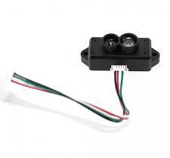
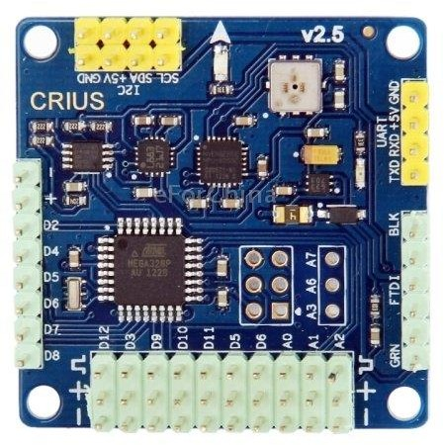
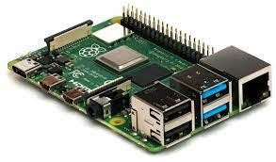
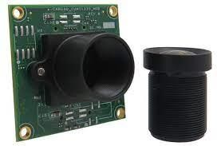
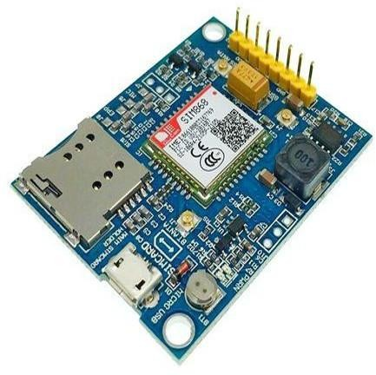
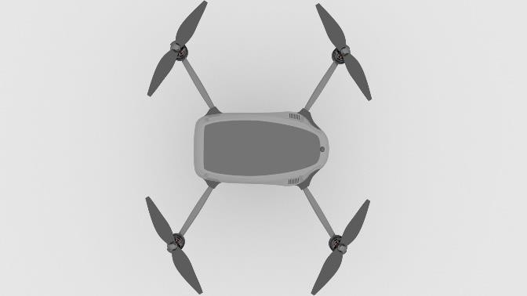

BLOCK DIAGRAM
Flight Controller
Single Board Computer
LIDAR Sensor
4K Camera
Sends data to the rescue team or the police station through LTE.
UA V
GSM & GPS
Module
EASWARI ENGINEERING COLLEGE

Slide 7
PROPOSED METHODOLOGY
Clearly define the problem you're addressing: developing an automated UAV system for
efficient search and rescue missions and crime detection.
Gather relevant data for lost persons (if available) and crime statistics in the targeted areas.
Create an algorithm to determine the optimal UAV deployment location based on the last
known location of the person.
Integrate an advanced autopilot system capable of autonomous flight, obstacle avoidance, and adaptive flight path planning.
Integrate GSM, GPS, and LTE modules for seamless communication and data sharing.
Choose appropriate uncrowded or high-crime areas for UAV deployment based on crime data.
Define thresholds and criteria for identifying potential crimes and emergencies.

Slide 8
HARDWARE AND SOFTWARE REQUIREMENTS WITH SPECIFICATIONS
UAV with flight controller
4x BLDC motors with ESCs
Laptop or mobile with software to receive the transmitted data
Raspberry pi with camara
LTE network module with GPS
High Power rechargeable battery
Lidar Sensors

Slide 9
TIMELINE
TIMELINE | PROCESS
August - September 2023 | Research and Planning Hardware Selection and Assembly
October - December 2023 | Software Development Autonomous Flight Testing
January 2024 – March 2024 | WiFi Repeater Communication Integration and System Testing
April 2024 | Performance Optimization and Refinement Documentation and Publishing

Slide 10
EXPECTED OUTCOMES
Rapid Assessment and Situational Awareness
Search and Rescue Operations
Hazardous Environment Exploration
Remote Monitoring and Communication
Data Collection and Analysis
Enhanced Decision-Making
Reduced Risk to Human Responders
Improved Resource Allocation
Public Safety and Community Engagement

Slide 11
CONCLUSION
Focused on analyzing LTE values for network coverage within a single cell, utilizing a Line-Of-Sight (LOS) radio propagation model. Notably, we achieved this by removing the RF controller from the UAV, leading to promising outcomes. The obtained level of accuracy holds significant potential, especially for rescue services. Nevertheless, it is important to acknowledge that potential errors might arise in regions characterized by limited visibility and higher moisture level

Slide 12
REFERENCES
https://www.sciencedirect.com/science/article/abs/pii/B9780128202 760000133
https://ieeexplore.ieee.org/document/9214241
https://www.sciencedirect.com/science/article/abs/pii/S1084804522 001370

